Slide 1
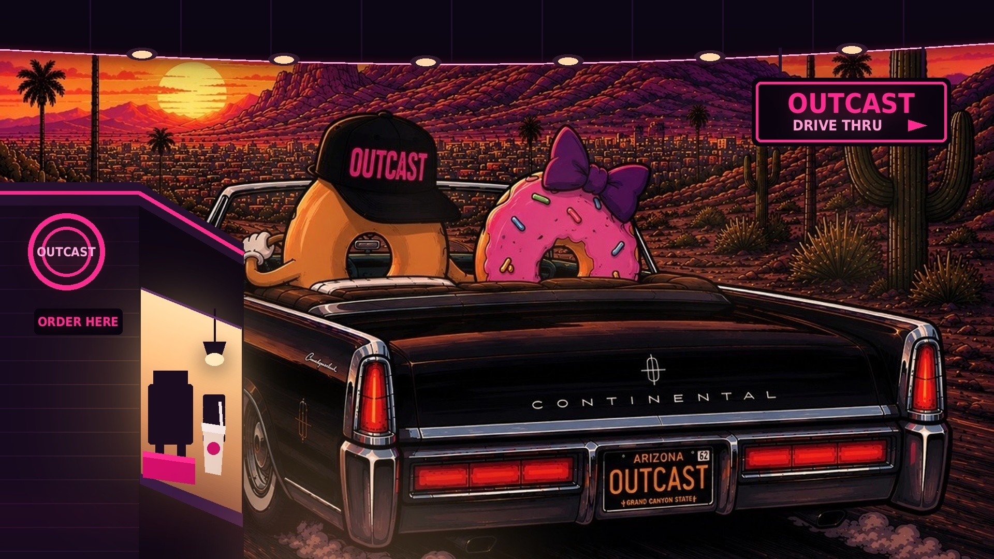
Fifteen more stores
in Phoenix.
$1,000,000 SEED · $10M POST-MONEY · METRO PHOENIX, ARIZONA
Notes:
The whole pitch in five words. We are not asking anyone to believe in a national chain — we are asking them to believe we can open fifteen more stores in a metro they live in and can drive to. Hayden is store one; sixteen is the plan.

Slide 2
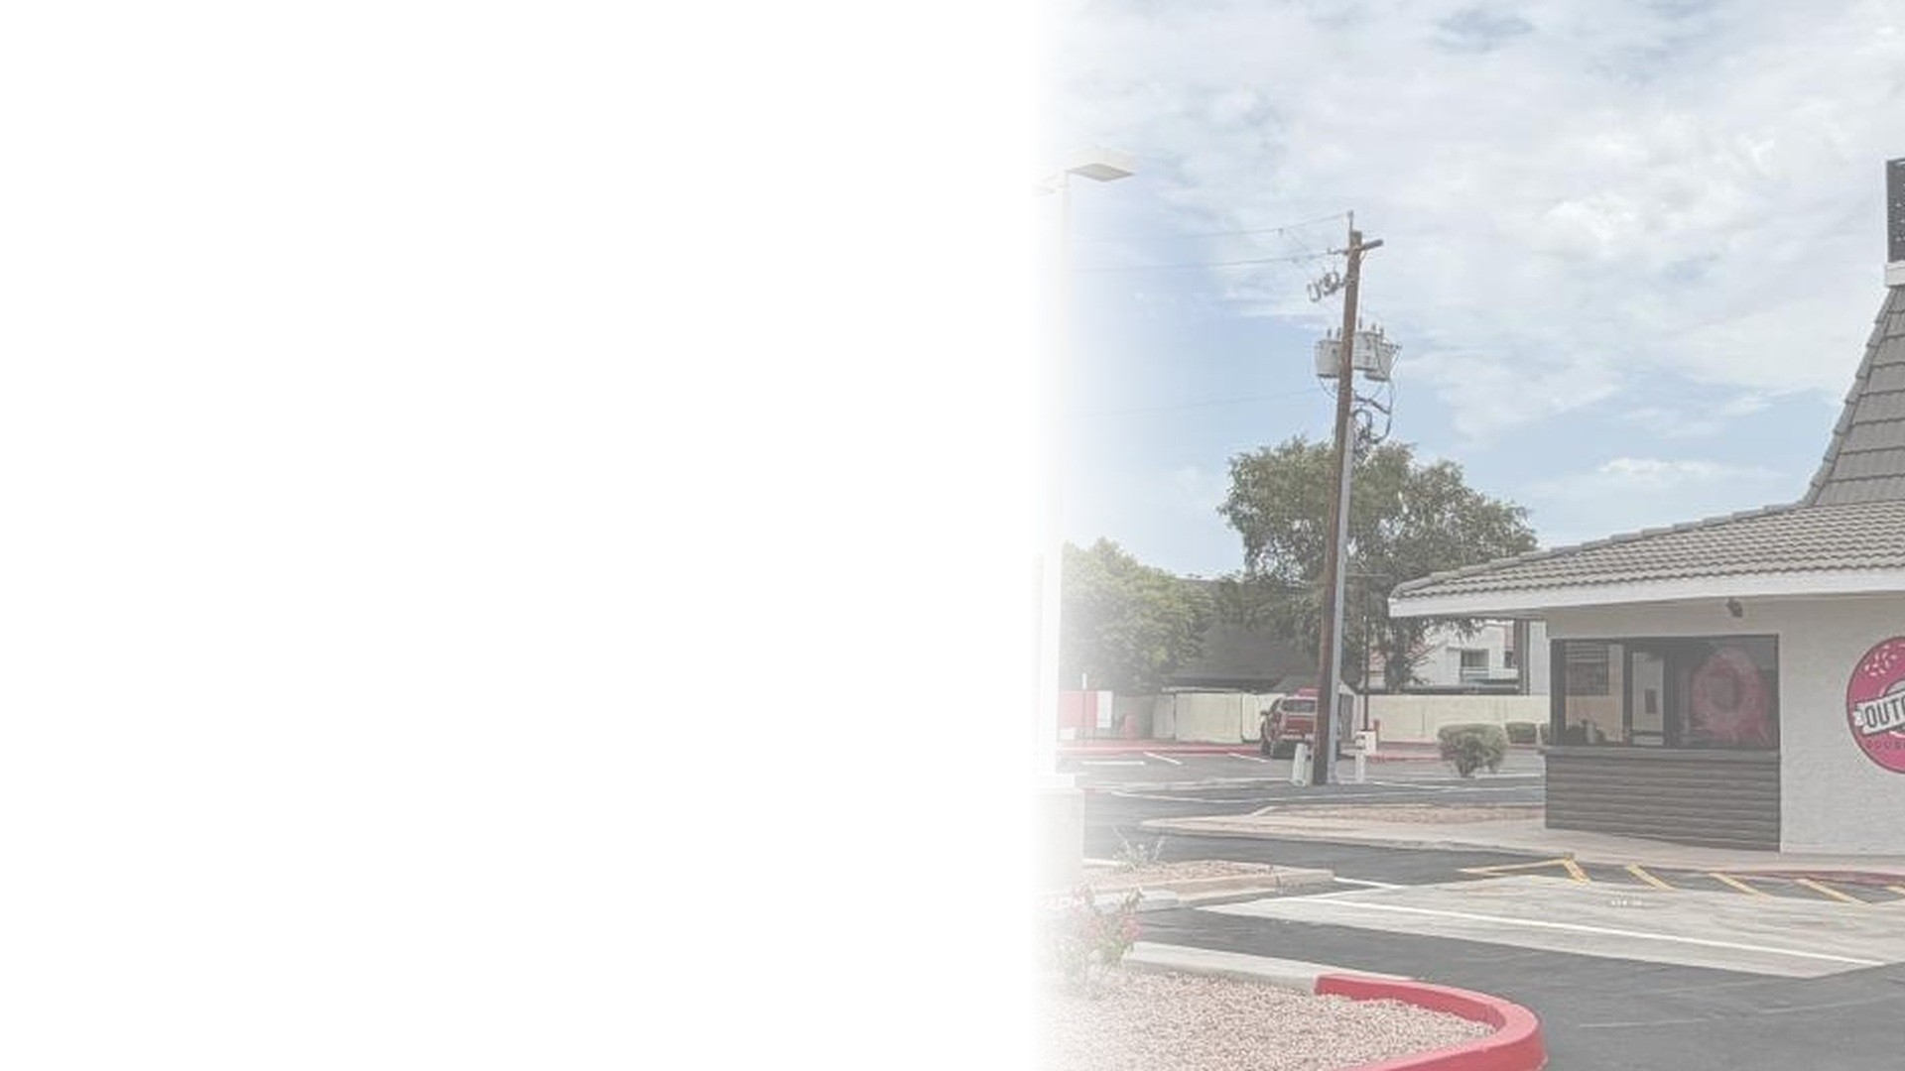
WHY NOW
The country moved to the
drive-through. Nobody moved
breakfast with it.
OFF-PREMISE IS THE DEFAULT
Limited-service off-premise traffic went from 76% of visits in 2019 to 83% in 2024.
THE DRIVE-THROUGH WON THE CHANNEL
41% of QSR customers prefer it — ahead of the counter at 26% and apps at 15%.
THE CATEGORY IS PROVEN AT SCALE
Dutch Bros runs 1,081 stores at $2.08M each. 7 Brew went from 40 stores to nearly a thousand in four years.
AND EVERY ONE OF THEM SELLS DRINKS
Dutch Bros is now bolting food onto eleven hundred stores built for cups. We built the food in.
Phoenix is the market they all want. Dutch Bros just bought back its East Valley franchise; 7 Brew's Phoenix developer is coming.
2
Notes:
Sources: National Restaurant Association; Intouch Insight 2024 QSR study; QSR Magazine (Dutch Bros AUV $2.081M, 1,081 stores); Restaurant Dive (7 Brew unit growth); BusinessWire, May 2026 (Dutch Bros acquisition of the Phoenix East Valley franchise).
THE URGENCY IS REAL AND IT IS LOCAL. The best drive-through operators in America have decided Phoenix is worth owning. We are already here, and we can be open in the East Valley before their developer breaks ground.

Slide 3
THE MARKET ALREADY EXISTS
Arizona supports eight hundred of these today.
Nobody has to be convinced that Arizona will buy coffee and breakfast from a drive-through. That question was answered by other people, with their own capital, over the last twenty years. The only open question is who opens the next fifteen.
BRAND
ARIZONA LOCATIONS
WHAT THEY SELL
Starbucks
603
Cafe and drive-through. Coffee plus a full food menu.
Dunkin'
114
Drive-through. Coffee, doughnuts and sandwiches.
Dutch Bros
86
Drive-through. Drinks. Food being retrofitted now.
Black Rock Coffee Bar
61
Drive-through. Drinks and light food. Sixty-one built from nothing.
7 Brew
3
Drive-through, drinks only — and one of the three is in Queen Creek.
OUTCAST TODAY
1
Everything above, in one window.
OUTCAST BY Q3 2030
16
One point eight percent of what Arizona already supports.
Black Rock went from zero to sixty-one Arizona stores. Dutch Bros from zero to eighty-six. Neither sells a real breakfast.
3
Starbucks and Dunkin' counts as of December 2025; Dutch Bros July 2024 and higher today; Black Rock August 2026; 7 Brew September 2026.
Notes:
THIS IS THE PAGE THAT MAKES SIXTEEN SOUND SMALL, AND THAT IS THE ENTIRE JOB OF IT. Do not argue that the market exists — show that other people already proved it with their own money, then point out how little of it we are asking for.
BLACK ROCK IS THE MOST USEFUL COMPARABLE IN THE ROOM. Sixty-one Arizona locations out of roughly two hundred nationally — nearly a third of a public company's footprint in this one state, built from a standing start, on drinks alone.
IF SOMEONE SAYS THE MARKET IS SATURATED: eight hundred locations is not saturation, it is proof of demand. And the two fastest-growing brands on that list are the two newest.

Slide 4
WHAT NONE OF THEM DO
Everybody sells the drink. Nobody sells the meal.
Every brand on the last page is a beverage business that tolerates food. We built the food in from the first store — so our ticket is roughly double theirs, and we need less than half the cars to make the same money.
DRIVE-
THROUGH
CRAFT
COFFEE
OWN ENERGY
LINE
FULL BREAKFAST
FOOD
MADE TO ORDER,
NOT REHEATED
UNDER 3 MIN
AT THE WINDOW
Starbucks
—
Dunkin'
—
Dutch Bros
—
Black Rock Coffee Bar
—
7 Brew
—
—
OUTCAST
● full ○ partial — none
Dope doughnuts and dope sandwiches. Elevated breakfast you would happily eat for lunch — out of a drive-through window.
4
Notes:
THE ONE-STOP-SHOP ARGUMENT, AND THE HONEST VERSION OF IT. Dunkin' is the only brand on this page that genuinely does both drinks and food — so do not claim the category is empty. Claim the quality gap, which is the real one.
THE LAST TWO COLUMNS ARE THE PAGE. Starbucks and Dunkin' have food and are slow. Dutch Bros, Black Rock and 7 Brew are fast and sell no meal. We are the only row that spans both — and spanning both is the whole company.
WHY IT MATTERS COMMERCIALLY. Dutch Bros does about $2M a store on drinks at roughly a $7 ticket — call it eight hundred cars a day. We do not need eight hundred cars, because our ticket carries food. Fewer cars, bigger ticket, and a second daypart. That is why a $1.4M store works for us and would be a disaster for them.
THE SPEED MARKS FOR COMPETITORS ARE DIRECTIONAL JUDGEMENTS, NOT MEASURED TIMES. Only the Outcast number is ours, and it must be literally true at peak — someone in the room will order a sandwich on the way home.

Slide 5
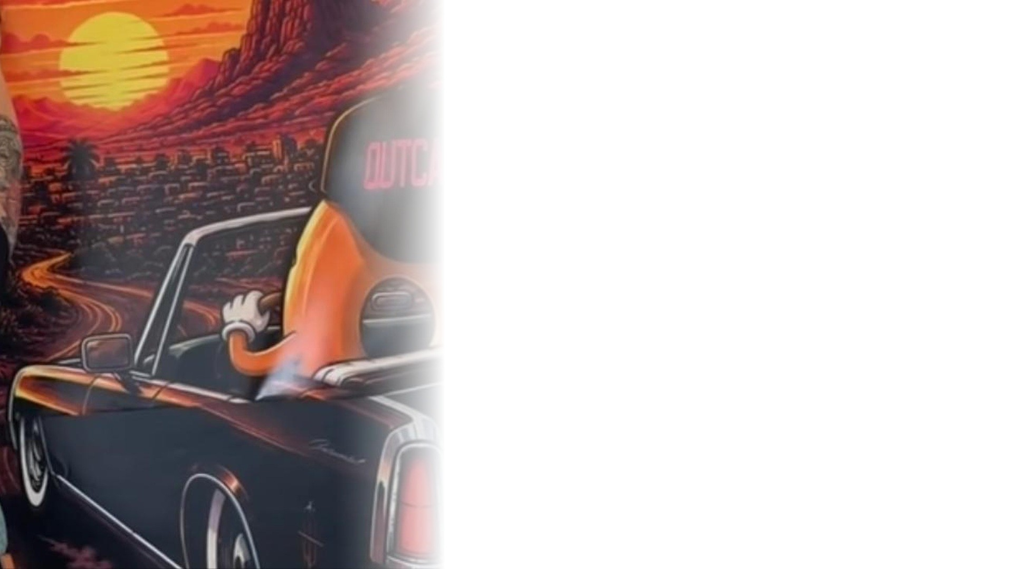
KEYS TO SUCCESS
Why we win.
01
BRAND
Arizona street art. Black and pink on every building, bag, box, cup and hoodie. The more we open, the more it works.
02
PRODUCT
The best doughnuts, coffee and breakfast sandwiches you can get in a drive-through.
03
EXPERIENCE
Chick-fil-A discipline. In-N-Out simplicity. An Arizona identity neither of them has.
04
ECONOMICS
$350,000 of store EBITDA on builds that increasingly cost $300,000, not $1 million.
05
ONE MARKET
Sixteen stores in one metro. Every store inside an hour of every other one, and of the people running them.
5
Notes:
Five keys in order of how hard they are to copy. The fifth is the one that separates this plan from the old one: we are not building a national chain from Arizona, we are building Arizona.

Slide 6
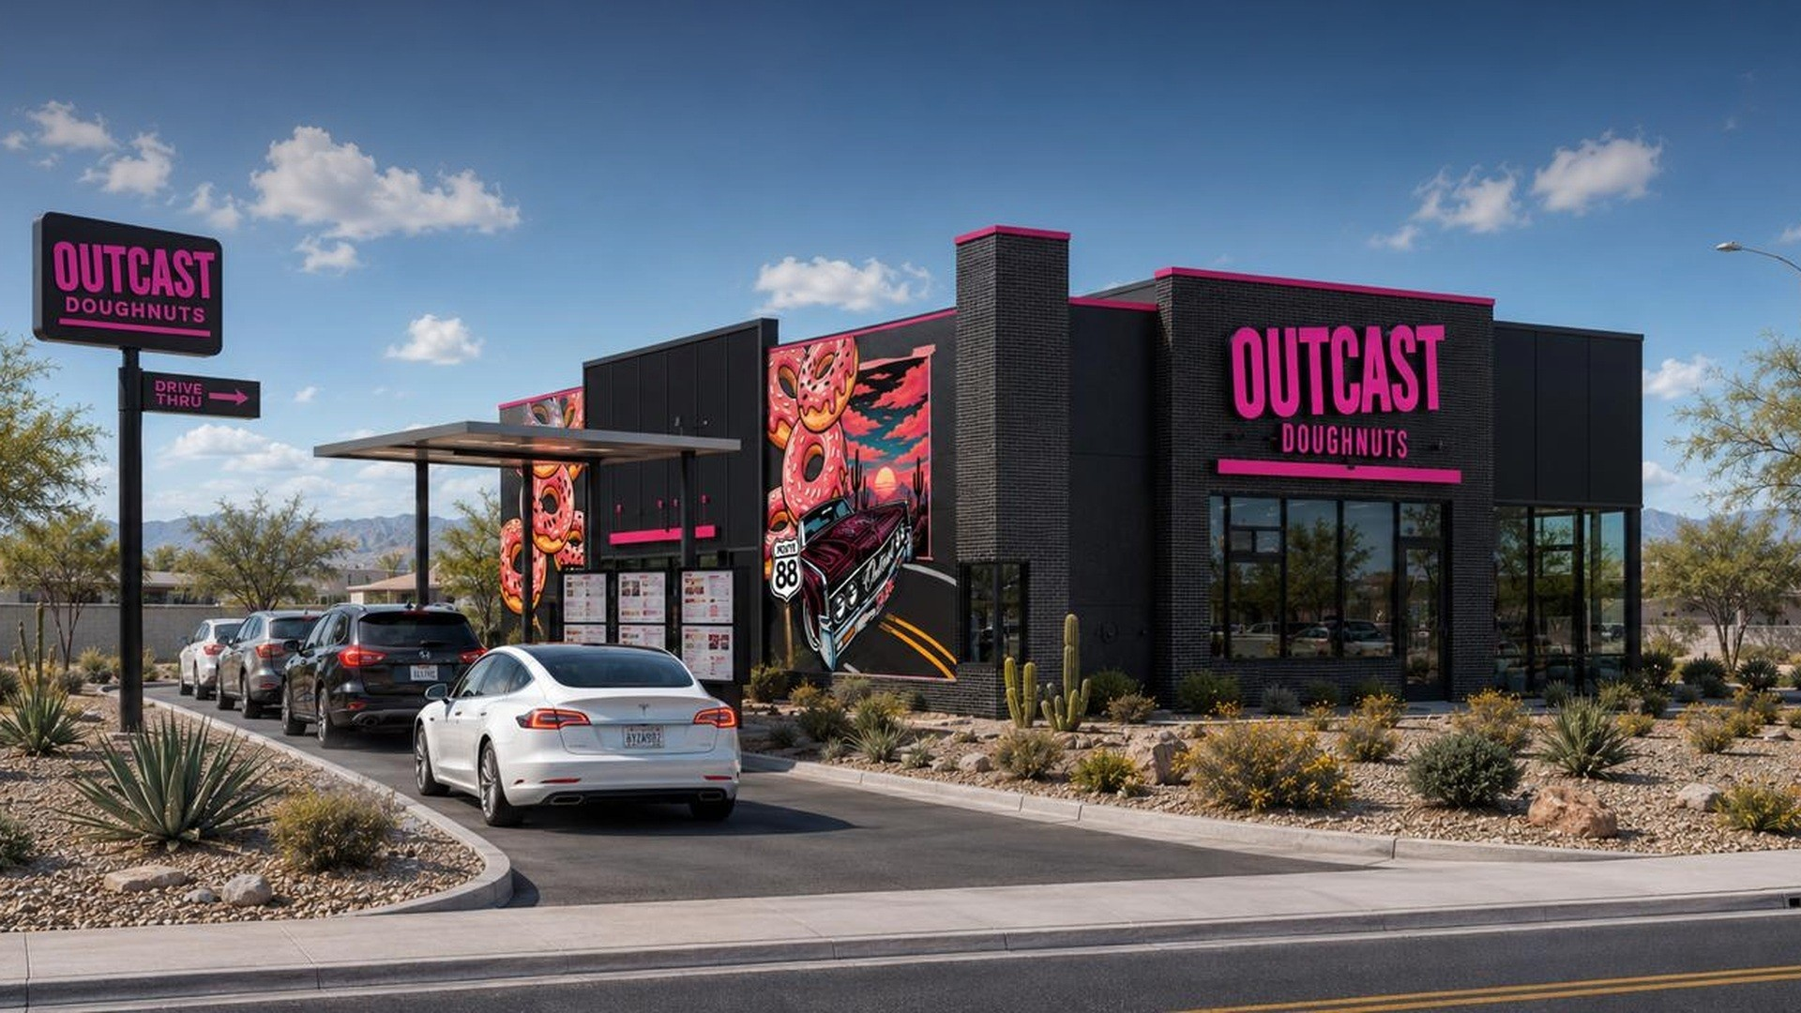
INCOMPARABLY DOPE
The brand is the asset. Everything else is evidence.
6
EAST MESA PROTOTYPE · RENDERING
Notes:
Almost no words on purpose. It is a rendering of the East Mesa prototype — say so, and replace it with a photograph the day it exists.

Slide 7
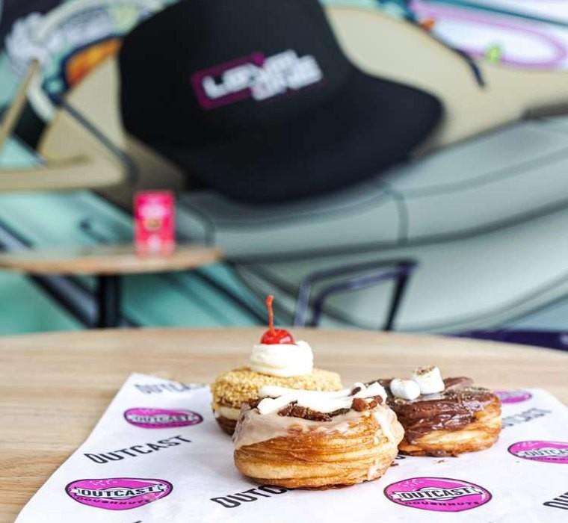
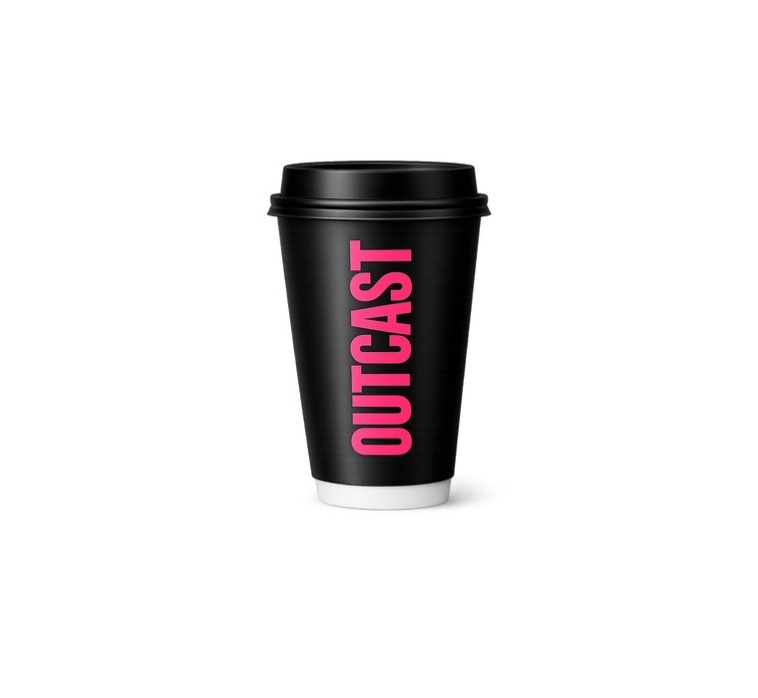
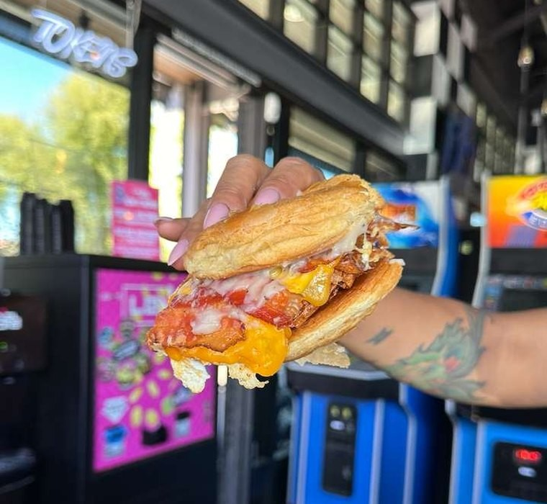
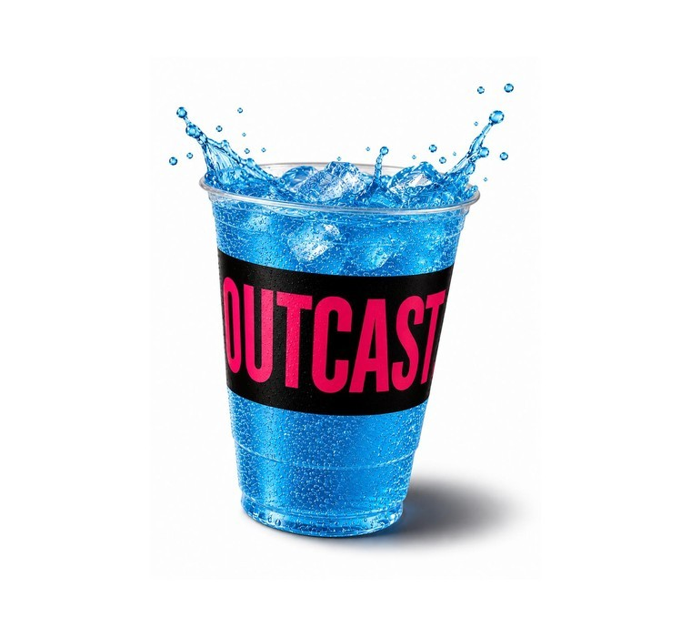
THE PRODUCT
Four lines. One ticket.
Two of these are things a drive-through coffee brand cannot make, and two are things a doughnut shop cannot pour. One window sells all four, and the ticket carries all four.
01
LAYERED DOUGHNUTS
02
SIGNATURE COFFEE
03
BREAKFAST SANDWICHES
04
AURA ENERGY
Laminated in layers, with toppings built to play off each other.
Drip, cold brew, espresso and signature lattes — hot, iced or blended.
Fresh-cracked egg, real cheese and premium meats on a doughnut-shaped croissant bun.
Our own energy line. The afternoon daypart, owned.
Dutch Bros does $2M a store on drinks alone, and is now adding food for a four-point lift. We start where they are trying to get to.
7
Notes:
EVERY ONE OF THESE IS A REAL PHOTOGRAPH OR A REAL CUP — nothing on this page is a mock-up, and that is worth saying out loud in a room that has seen a hundred concept decks.
THE FOUR-LINE ARGUMENT IS AN ECONOMIC ONE, NOT A MENU ONE. Doughnuts and sandwiches carry the ticket; coffee and Aura carry the frequency and the second daypart. A retrofit buys Dutch Bros about four points of comp. Say the number and let them draw the conclusion.

Slide 8
WHAT IS ALREADY OPEN
Hayden is open. Everything after it is a repeat.
Three years in Mesa building the concept and dialing in the menu. That shop closed in July 2026 and the drive-through opened in August. Hayden is store one — and every store after it is a repeat of it, not of the shop.
$1.4M
21.6%
120 DAYS
< 3 MIN
designed AUV
store margin at maturity
lease to open
ticket at the window
WHAT THIS ROUND DOES TO IT FIRST
Marketing consistency, before anything else.
$120K
Hayden is open and under-marketed. Consistent local marketing is the cheapest revenue in this plan, and it sets the AUV that every one of the next fifteen stores is underwritten against. It is the first line of the use of funds for a reason.
of this round goes to Hayden marketing
8
Designed figures, not actuals. Every number in this deck traces back to one open store. Ask to see it.
Notes:
SAY THE MESA CLOSURE BEFORE ANYONE FINDS IT. The original shop closed in July 2026, a month before Hayden opened. Somebody will drive past a dark storefront or search it. Told first and plainly it is a format decision — the shop was the test kitchen, the drive-through is the business. Discovered later it looks like a failure being hidden.
REPLACE THE DESIGNED FIGURES WITH HAYDEN ACTUALS AS SOON AS THERE ARE TWELVE WEEKS OF THEM. Until then say 'designed' and mean it. If Hayden is annualising above $1.4M, lead with that instead — it is the strongest fact available.

Slide 9
THE UNIT
Where $350,000 a store comes from.
The Scottsdale drive-through at $1.55M of sales, built on the KPI targets TJ already runs the company on. Nothing here requires a capability we do not have.
TJ'S TARGETS
Net sales
$1,550K
100.0%
< 25%
< 25%
Cost of goods sold
($364K)
23.5%
cost of goods
labor
Labor
($398K)
25.7%
Prime cost
($762K)
49.2%
< 12%
> 20%
Occupancy and rent
($180K)
11.6%
rent factor
store EBITDA
Other operating expense
($211K)
13.6%
Local marketing
($31K)
2.0%
ACROSS SIXTEEN
Store-level EBITDA
$366K
23.6%
$352K
is the blended store EBITDA across all sixteen, built bottom-up store by store — not assumed.
Dutch Bros does $2M a store on a $7 ticket — call it eight hundred cars a day, nearly all of it before eleven. We do $1.55M on a ticket that carries food, across three dayparts.
9
Fewer cars, bigger ticket — and that is what lets a cheaper corner work.
Notes:
THE HONEST VERSION. A $1.4M store does not earn a $1.8M store's margin — labor and overhead are partly fixed, so the same structure gives 24% labor at $1.8M and 27% at $1.4M. That is volume, not execution. The $352K blended figure already carries it.
THE CARS LINE IS THE MOST IMPORTANT SENTENCE ON THE PAGE AND IT IS EASY TO RUSH. A drinks-only brand needs eight hundred cars a day through one morning peak. We need roughly half that across three dayparts. That is why we can take a corner they would reject, and it is the reason the conversion page on the next slide works at all.
RENT AT 11.6% IS DELIBERATE. Twelve is the ceiling, not the target — sale-leaseback pushes it up because TJ would rather have capital in stores than in land. This room owns real estate; they will find this line.

Slide 10
THE THING WE LEARNED
The same store, for a third of the money.
Metro Phoenix is full of abandoned small-format drive-through boxes — the lane, the window and the pad are already there. Converting one costs a fraction of building one, and it sells nearly the same. It works for us because we do not need a corner that delivers eight hundred cars a day.
GROUND-UP
CONVERSION
$1.0M
to build
$300K
to build
$1.8M
annual sales
$1.4M
annual sales
$475K
store EBITDA
$317K
store EBITDA
2.1 years
to return the build
11 months
to return the build
Eight of the next eleven stores are conversions. That is what lets $7 million buy eleven stores instead of four — and it is why this plan carries almost no debt.
10
Both build costs are management estimates. No store has been built on the $300,000 conversion figure, and the $1M ground-up assumes a landlord contribution of the kind being negotiated at East Mesa.
Notes:
THIS IS THE BEST PAGE IN THE DECK AND ALSO THE ONE TO BE CAREFUL WITH. The $300K is an estimate until Gilbert or Queen Creek is actually built. Say 'we believe' until it is a receipt.
THE CAUSAL SENTENCE IS THE THIRD ONE IN THE PARAGRAPH. Cheap boxes are available to everyone — they are useful to us because our ticket carries food and our demand spans three dayparts, so we do not need the eight-hundred-car corner a drinks-only brand has to win. That is why Dutch Bros cannot run this play and we can.
EXPECT THE FOLLOW-UP: how many of these boxes exist? Have the answer — named addresses, not a category. A well-capitalised competitor entering Phoenix wants exactly the same inventory.

Slide 11
WHY THIS SCALES
We didn't design a restaurant. We designed a repeat.
STORE PROTOTYPE
SITE SELECTION
TRAINING
One footprint, drive-through first. Hayden is unit one.
Underwritten before we sign a lease. Conversions first, ground-up where the corner earns it.
A crew is certified, not hired.
ONE OPERATING DISCIPLINE
MARKETING
MANAGEMENT
Store sixteen makes the same calls as store one, and can prove it.
Built once, run in every store, measured at the ticket.
GMs who have already run the prototype, hired ahead of the opening.
LEASE SIGNED
OPEN
FULL PROFIT
120 DAYS
+60 DAYS
11
Item five of the use of funds builds all of this once — for sixteen stores rather than five.
Notes:
A hundred and twenty days from lease to open on a conversion, and sixty more to full profit. That is the line to leave them with — and it is a conversion number, not a ground-up number. A ground-up build takes longer and TJ should say so if asked.

Slide 12
HOW WE BUILD DEMAND
Seven posts a week. The same seven, every week.
Outcast already has 10,500 followers and 442 posts. The gap was never reach — it was rhythm. Every day has a name, a platform and a person, so nobody has to decide what to make in the morning.
THE WEEK
TWO AUDIENCES, TWO PLATFORMS
MON
MENU MONDAY
the product hero
INSTAGRAM
Moms, hospital staff, local business. They buy for a household, not for themselves. Polished product, community proof.
TUE
BEHIND THE WINDOW
crew personality
WED
HOW IT'S MADE
the build, the craft
TIKTOK
Their kids. The local high school. Personality and speed — they do not want an ad, they want a person they recognize.
THU
AURA HOUR
the afternoon daypart
FRI
FEATURE FRIDAY
hospital, school, neighbour
AND THREE PEOPLE WHO ALREADY WORK HERE
SAT
THE RUSH
the line, the volume
AIDEN
runs it. Directs, shoots, edits, publishes.
SUN
ARIZONA
brand. nothing sold.
TJ
on camera. Fifteen minutes a week.
MACEE
the Instagram audience and the creators.
12
Dutch Bros runs paid media at under 2% of revenue and puts 73% of transactions through its own channels. Demand in this category is earned, not bought.
Notes:
THE POINT OF THIS PAGE IS NOT THE IDEAS, IT IS THE RHYTHM. Any operator can post. Almost none post seven days a week for a year. A named day, a named platform and a named person means nobody wakes up wondering what to shoot.
IF ASKED WHAT COULD GO WRONG: this depends on one person. Aiden leaving is the risk, which is why the SOP exists and why the crew feeds a shared folder rather than holding the accounts.
Six-month daily calendar, SOP and budget are in the workbook.

Slide 13
WHAT IT COSTS
The engine is central. Only the ad spend scales.
One content director serves one store or sixteen. That is why marketing gets cheaper per store as we grow — and why this is a line in the use of funds rather than an afterthought.
1 STORE
5 STORES
16 STORES
Central content engine
$31.6K
$36.3K
$53.0K
Per-store program
$12.6K
$63.0K
$201.6K
Total annual marketing
$44.2K
$99.3K
$254.6K
System revenue
$1.4M
$7.2M
$23.8M
MARKETING AS % OF SALES
3.2%
1.4%
1.1%
WHAT IT BUYS, EVERY MONTH, PER STORE
AND ONE-TIME, FOR EVERY NEW STORE
$1,050
$15 a day behind whichever post already worked · two or three local creators · a limited sticker drop · one community day · one LTO.
$6,500
Six-week countdown · a creator preview the night before · a free-drink day · street sampling · geo-targeted paid inside three miles.
13
Notes:
THE 2% LINE IN THE MODEL HAS ROOM. Local marketing is underwritten at 2.0% of sales throughout; this program fits inside that at every store count, and Dutch Bros runs paid media under 2% of revenue at more than a thousand stores.
THE PRE-OPENING PLAYBOOK IS THE DUTCH BROS ONE, SCALED DOWN. $6,500 a store, most of it product cost, is a rounding error against a $300K conversion — and a queue on day one is worth more than any media buy.

Slide 14
WHAT THE MILLION DOES
Five things, in this order.
01
HAYDEN — MARKETING CONSISTENCY
$120K
The cheapest revenue in the plan, and it sets the AUV every later store is underwritten against.
02
EAST MESA — HIGHEST PRIORITY
$600K
Our equity in the ground-up build, alongside a landlord contribution, sale-leaseback and equipment financing. The prototype store, and the largest single use of this round.
03
GILMORE — OPERATING INCOME
$50K
Opens April 2027 and contributes cash while the drive-throughs ramp.
04
GILBERT AND QUEEN CREEK — SITE CONTROL
$80K
Identify, letter-of-intent and deposit on two conversion sites. Every month of delay is a box someone else takes.
05
THE OPERATING SYSTEMS
$100K
Marketing, core operations and technology, built once for sixteen stores rather than five.
Working capital and contingency
$50K
Four openings in one year. Something will cost more than planned.
TOTAL
$1,000K
14
Notes:
BE STRAIGHT ABOUT WHAT THIS ROUND DOES NOT DO. $1M does not build four stores. It is the equity slice of a stack that also uses sale-leaseback on East Mesa and equipment financing on the conversions — the model shows a peak of about $3.2M of that debt in 2027, repaid in full when the Series A closes. Its real job is five open stores with instrumented economics by the end of 2027, because that is what the Series A prices off.
CONTINGENCY IS $50K AGAINST FOUR OPENINGS. That is thin and a careful investor will say so. Either justify it or say what gets cut first.

Slide 15
THE SIXTEEN
16
One metro. Every store inside an hour.
STORES BY Q3 2030
OPEN OR FUNDED BY THIS ROUND
THE SERIES A — EAST VALLEY AND NORTH
THE SERIES A — WEST AND CENTRAL
5
5
6
Hayden / Scottsdale
Chandler
Phoenix Midtown
open Aug 2026 · unit one
2028
2029
Gilmore
Tempe
Arcadia
Apr 2027
2028
2029
East Mesa
Scottsdale North
Goodyear
Apr 2027 · ground-up
2028
2030
Gilbert
Peoria
Buckeye
2027 · conversion
2029
2030
Queen Creek
Glendale
Surprise
2027 · conversion
2029
2030
Ahwatukee
2030
15
The original Mesa shop, where the concept was built, closed in July 2026. Hayden is store one. Sites beyond Gilbert and Queen Creek are the plan, not commitments.
Notes:
CONFIRM EVERY NAME ON THIS PAGE WITH TJ BEFORE IT GOES OUT. Named markets get diligenced, and a local investor will know which corners are real.

Slide 16
THE NEXT ROUND, NAMED NOW
Five stores make the Series A raisable.
A growth investor's second question is always what comes after them. Here it is in advance — and unlike most plans, this one only has one more round in it.
WHEN
2028
On five open stores with a full year of instrumented economics behind them.
HOW MUCH
$7 million
Eleven more stores — eight conversions and three ground-ups.
WHAT IT COSTS YOU
20% dilution
Your 10% becomes 8%. That is the only dilution in this plan.
WHAT IT BUYS
5 → 16 stores
$23.8M of system revenue and $5.6M of store-level EBITDA by Q3 2030.
Sixteen Arizona stores funded by $8 million of equity and cash the stores generate. Nothing beyond that is priced into this round.
16
Notes:
THE SERIES A PRE-MONEY IS AN ASSUMPTION, NOT A TERM SHEET — say so. It produces the 20% dilution used throughout. If the round prices higher, the seed does better, not worse.
THE SERIES A IS NOT IN OUR CONTROL AND THE DECK SHOULD NOT PRETURE OTHERWISE. If asked what happens without it: five stores standing alone still generate roughly $1.75M of store EBITDA. Smaller, slower, still a business — but be ready with that number rather than improvising it.

Slide 17
THE ARC
Five years, in one table.
2026
2027
2028
2029
2030
Stores open, end of year
1
5
8
12
16
System revenue
$0.5M
$3.7M
$8.6M
$13.8M
$19.8M
Store-level EBITDA
$60K
$554K
$1.6M
$2.9M
$4.3M
Corporate G&A
($342K)
($786K)
($1.1M)
($1.5M)
($1.8M)
Corporate EBITDA
($431K)
($832K)
$60K
$809K
$1.9M
Net debt
—
$2.7M
net cash
net cash
net cash
At maturity: $23.8M of system revenue, $5.6M of store EBITDA — $352,000 a store — and $3.9M after corporate overhead.
17
Notes:
2026 AND 2027 ARE NEGATIVE AT THE CORPORATE LINE AND THAT IS THE PLAN. Four openings in one year carry $600K of pre-opening expense, and we are staffing corporate for sixteen stores rather than five. The stores themselves are profitable throughout. Say that before anyone asks.

Slide 18
THE RETURN
$1,000,000 at a $10 million post-money.
10.0%
8.0%
4 YEARS
at close
after the Series A
to a Q3 2030 exit
EXIT AT 10x EBITDA, Q3 2030
STANDALONE BUYER
STRATEGIC BUYER
EQUITY VALUE
$39.9M
$57.0M
Prices corporate EBITDA of $3.9M, or store EBITDA of $5.6M
YOUR PROCEEDS
$3.2M
$4.6M
On 8.0% retained through the Series A
MOIC AND IRR
3.2x · 34%
4.6x · 46%
On the original $1,000,000, over four years
AND IF NOBODY BUYS IT: sixteen unlevered stores throw off $3.9 million a year. On 8% that is roughly $314,000 annually — a 31% yield on the original million, indefinitely. The floor here is a distribution, not a zero.
18
Notes:
SHOW BOTH COLUMNS AND SAY WHICH IS REAL. Nobody buys sixteen stores as a financial buyer, so the strategic column is the base case — an acquirer already has a back office. But quoting one number invites the question you did not answer.
AND STRESS THE MULTIPLE. At 8x the return is 2.5x standalone and 3.6x strategic. At 6x it is 1.9x and 2.7x. Every one of those is a good outcome, and showing the range is what makes 10x credible instead of hopeful.
THE FLOOR LINE HAS A CONDITION AND AN HONEST INVESTOR WILL FIND IT: sixteen stores only exist if the Series A happens. Be ready to give the five-store version of the floor instead of defending this one.

Slide 19
WHO BUYS THIS
Not Roark. Not yet.
Roark buys at three hundred stores. A sixteen-store Arizona chain with $5.6 million of store-level EBITDA sells to someone smaller and closer — and there are more of them than there are Roarks.
Q3 2030
$40M – $57M
depending on whether the buyer absorbs the overhead.
A REGIONAL PRIVATE-EQUITY FUND
Buys a proven single-market platform and funds the next fifty stores itself.
A MULTI-BRAND FRANCHISE PLATFORM
Adds a breakfast concept to a portfolio that already has the back office.
A LARGER OPERATOR WANTING PHOENIX
The fastest way into a market where the good corners are already taken.
OR NOBODY — AND WE KEEP IT
Sixteen unlevered stores distributing cash is not a failure case.
19
Precedent, not promise. No acquirer has expressed any interest in the company.
Notes:
THIS PAGE IS DELIBERATELY SMALLER THAN A BILLION-DOLLAR STORY, AND THAT IS THE POINT. Underwrite the floor and keep the ceiling free. The fourth bullet is the one people remember.
IF ASKED WHY NOT FRANCHISE: a converted box costs $300K and throws off $317K a year — eleven-month payback. A 7 Brew franchisee invests $894K to $2.2M and waits six to eight years, and we would collect about fifty thousand in royalties. Texas is the trigger, and that is a Series B conversation. Have a franchise attorney check any term before quoting it.

Slide 20
THE HORIZON — NOT IN THIS ROUND
Sixteen stores is the plan. Forty-one is the map.
A Series B after Arizona would take the format into three markets the category has already proven. The return on the previous page assumes none of this happens — it is underwritten to sixteen Arizona stores and a 2030 exit. This is what we would do instead if the stores keep working.
PHASE ONE · 2026–2030
PHASE TWO · 2031–2032
PHASE THREE · 2033–2034
ARIZONA
NEVADA + UTAH
TEXAS
16
+13
+12
16 open
29 open
41 open
This round and the Series A. One metro, every store inside an hour.
Adjacent drive markets. Utah has the youngest population in the country.
Dallas–Fort Worth first. The only market here big enough to hold the rest.
METRO PHOENIX (16)
Mesa · Scottsdale · Gilbert · Queen Creek · Chandler · Tempe · Peoria · Glendale · Buckeye · Arcadia · Surprise · and five more
LAS VEGAS (6)
Henderson · Summerlin · Centennial Hills · North Las Vegas · Southwest · Enterprise
WASATCH FRONT (7)
Lehi · American Fork · Orem · Provo · Draper · South Jordan · Layton
DALLAS–FORT WORTH (12)
Frisco · Plano · McKinney · Allen · Prosper · Little Elm · Denton · Flower Mound · Southlake · Arlington · Mansfield · Fort Worth Alliance
WHAT FORTY-ONE STORES WOULD BE WORTH, AT FOUR-STATE SCALE
× 11 TURNS
41 stores × $350K = $14.4M store EBITDA − $4.4M corporate = $10.0M
$110M
20
Illustrative. No sites, no leases and no capital committed outside Arizona. Dutch Bros went Arizona, then Nevada and Utah, then Texas — where it now runs 142 stores, more than any state outside the West Coast.
Notes:
THE ONLY JOB OF THIS PAGE IS TO SHOW THE CEILING WITHOUT ASKING ANYONE TO PAY FOR IT. Say it plainly: the return you just saw assumes we sell sixteen Arizona stores in 2030 and never leave the state. If someone tries to underwrite the $110M, pull them back — it is a map, not a model.
WHY THESE THREE MARKETS. Nevada and Utah are drive markets from Phoenix — the same crew can open them. Utah is the best drink market in the country: youngest population, largest households, and a native drive-through drink culture that produced Swig before anyone called it dirty soda. Texas is the scale market, and it is the one we cannot open from Phoenix — it needs a second operating base, which is what a Series B pays for.

Slide 21
THE SAME TEST, FOUR STATES
Three thousand seven hundred of these already exist.
Page three made this argument for Arizona. It holds in every market on the previous page — and it holds hardest in Texas, where the field is more than twice the size of the other three combined.
ARIZONA
NEVADA
UTAH
TEXAS
Starbucks
614
293
154
1,494
Cafe and drive-through. Coffee plus a full food menu.
Dunkin'
119
40
~7
254
Drive-through. Coffee, doughnuts and sandwiches.
Dutch Bros
85
35
30
220
Drive-through. Drinks. Food being retrofitted now.
Black Rock Coffee Bar
61
—
—
47
Two hundred stores in seven states — and none in Nevada or Utah.
7 Brew
3
—
6
158
Drinks only. Texas is where it went first and hardest.
Swig
6
2
48
29
Utah's own. Proof the drive-through drink habit is native there.
THE FIELD TODAY
888
370
245
2,202
OUTCAST AT FORTY-ONE
16
6
7
12
1.8%
1.6%
2.9%
0.5%
Forty-one stores is one percent of what these four states already support.
21
Starbucks, Dunkin', Dutch Bros and Swig: poidata.io, July–August 2026. Black Rock: company releases, December 2025 (TX) and August 2026 (AZ). 7 Brew: company locator, September 2026. Counts move weekly; treat as orders of magnitude.
Notes:
THIS PAGE IS PAGE THREE AGAIN, WITH THE MAP OPENED UP. Same argument, four times the field. Do not linger.
THE TWO FACTS WORTH SAYING OUT LOUD. Black Rock has two hundred stores across seven states and zero in Nevada or Utah. 7 Brew has none in Nevada. Those are not markets anyone decided against — they are markets nobody has reached, and they are a four-hour and a ten-hour drive from Phoenix.
UTAH IS THE MOST INTERESTING COLUMN AND PEOPLE WILL MISS IT. The national drive-throughs are thin — 154 Starbucks, 30 Dutch Bros, no Black Rock — but Swig alone runs 48 stores. The drive-through drink habit is already native; what is missing is anybody serving real food through the window.
SOURCE DISCIPLINE. Third-party scrapes, not audited counts. Providers disagree by 10-20%. Quote them as approximate and never argue a single digit.

Slide 22
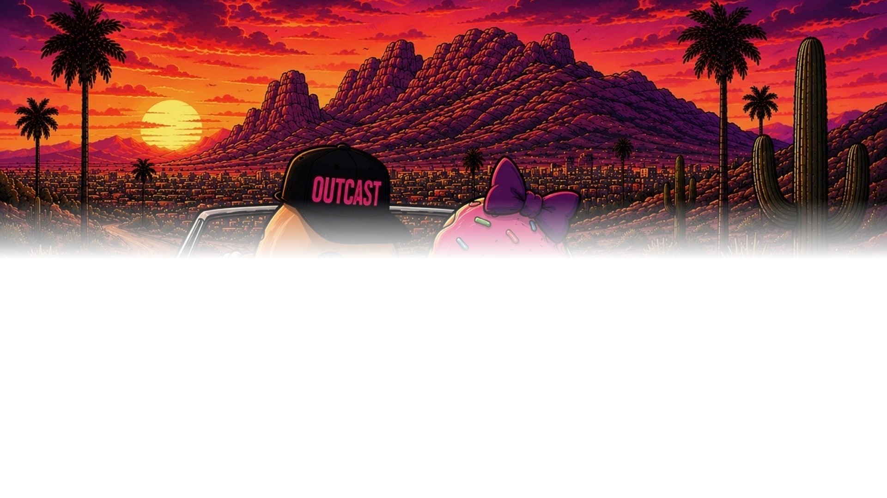
THE RAISE
$1,000,000
TJ TILLMAN
tj@dopeventures.org
on a $10 million post-money · the round buys 10.0%
FIVE STORES OPEN BY END 2027
ONE OPERATING SYSTEM
Hayden marketed properly, East Mesa built, Gilmore earning, Gilbert and Queen Creek under control.
Marketing, operations and technology built for sixteen stores, not five.
A $7M SERIES A IN 2028
SIXTEEN STORES BY Q3 2030
Priced off five instrumented stores. One more round, then no more dilution.
$23.8M of revenue, $5.6M of store EBITDA, and a company someone wants to buy.
22
One million to open four stores. Seven million to open eleven more. Then it is a business, not a plan.
Notes:
$1M on a $10M POST-money — a $9M pre. The round buys 10.0%; a $500K cheque is 5.0%.
BE PRECISE ABOUT WHAT THIS ROUND BUYS. $1M does not build four stores on its own — it is the equity slice of a stack that also uses sale-leaseback on East Mesa and equipment financing on the conversions, peaking near $3.2M in 2027 and repaid when the Series A closes.
TJ's contact line is on the page — say it out loud as well, and follow up the same day.

Slide 23
IMPORTANT INFORMATION
Please read this page.
EVERY FORWARD FIGURE IN THIS DECK IS A PROJECTION
THIS IS NOT AN OFFER
This presentation is for information and discussion only. It is not an offer to sell, or a solicitation of an offer to buy, any security. Any offering will be made only to qualified investors, and only through definitive offering documents that supersede everything in this deck.
THESE ARE PROJECTIONS, NOT FORECASTS
Store counts, revenue, margins, capital structure, valuations, multiples and returns here are forward-looking statements built on assumptions the company believes are reasonable today. They are not guarantees. Actual results will differ, and may differ materially. No return, no exit and no timeline described here is promised or assured.
THE OPERATING FIGURES ARE UNAUDITED
Average unit volume, store-level margin, build costs and the KPI targets reflect management's own figures for the Hayden location and its estimates for future stores. They have not been audited or independently verified.
THE CONVERSION ECONOMICS ARE AN ESTIMATE
The $300,000 build cost and $1.4 million volume attributed to a converted drive-through are management estimates. No store has yet been built on those figures, and the availability of suitable sites in Metro Phoenix has not been independently confirmed.
EXIT PRECEDENTS ARE NOT PREDICTIONS
Transactions involving other companies are included to describe the market for businesses of this type. They are not evidence of what Outcast will achieve, and no acquirer has expressed any interest in the company.
THIS IS NOT ADVICE
Nothing here is investment, legal, tax or accounting advice. An investment of this kind is illiquid, involves a substantial risk of loss including loss of the entire amount invested, and is suitable only for investors who can bear that risk. Consult your own advisers.
23
Outcast Doughnuts · Metro Phoenix, Arizona · TJ Tillman, tj@dopeventures.org · Confidential
Notes:
Baseline language only. It does not replace review by securities counsel, which this raise needs before the deck goes to any investor.

